Slide 1
Minor Project Presentation Text Orientation
Manipal university Jaipur

Slide 2
Introduction
Text orientation optimization is a critical task in image processing, particularly in the field of optical character recognition (OCR). The aim is to correct the slant, skew, or de-skew of text in images to ensure accurate recognition. The traditional methods of text orientation optimization such as edge detection, Hough transforms, and template matching are often time-consuming and inaccurate. In recent years, deep learning models have shown promising results in text orientation optimization.

Slide 3
Literature Review
Studies have shown that deep learning models can accurately detect and correct the slant, skew, or de-skew of image text. Convolutional Neural Networks (CNNs) and Natural Language Processing (NLPs) are some of the most widely used deep learning models for text orientation optimization. These models have been trained on large datasets of images with text in different orientations and have shown improved accuracy compared to traditional methods.

Slide 4
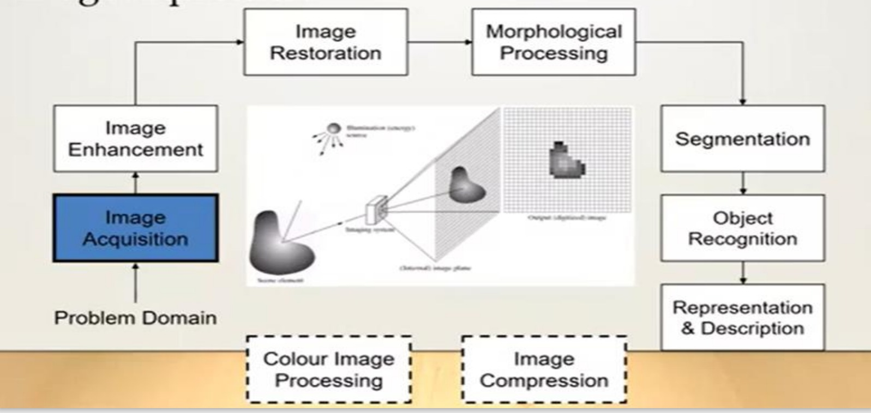

Slide 5
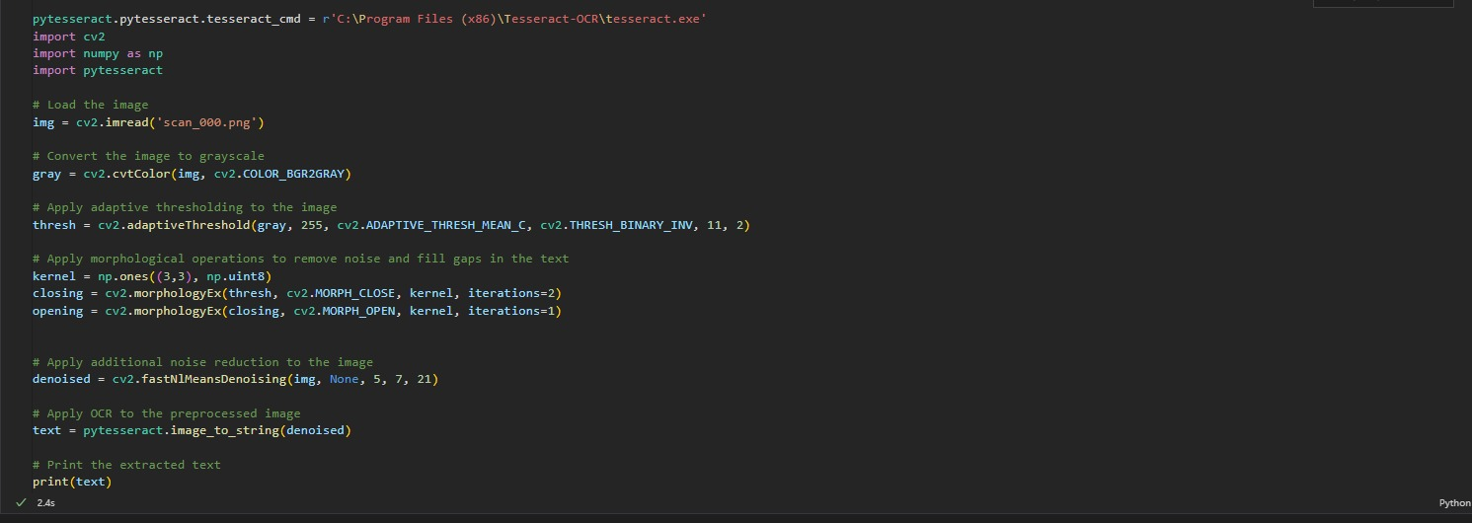
this is the code we are for pre-processing of image data set we have for our problem the image is converted to grayscale, and adaptive thresholding is applied to the image to binarize the text. then Morphological operations are then applied to remove noise and fill gaps in the text.
Pre-Processing Of Image

Slide 6
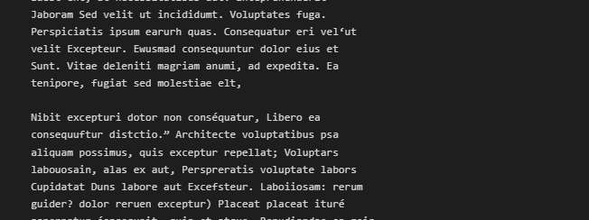
The code takes an input image, applies several preprocessing techniques to enhance the quality of the image for OCR, and displays the preprocessed image or a visual representation of the preprocessing steps as output and we are getting accuracy of 94%
OUTPUT OF THE PREVIOUS CODE

